Slide 1


A Game Changer for the Physical Inactivity Crisis?

Slide 2











OUR TEAM
Angela Tseng
Changhyeon Yoo
Kelly Zhang
Raj Mehta
Areeba Farooq
The Literature Master
The DiD Master
The Visualization Master
The “Catch Them All” Regression master
The RD Master

Slide 3
‘Fifty years from now when they ask: “What ended America’s obesity epidemic" the answer will be #PokémonGO’.
— Emily Miller, July 12, 2016

Slide 4
TABLE OF CONTENTS
01
04
02
05
03
06
MOTIVATION
DATA
LITERATURE REVIEW
FINDINGS
METHODOLOGY
CONCLUSIONS / LIMITATIONS

Slide 5
01
MOTIVATION

Slide 6
The Continous Growth of AR Games Market & Pokémon GO
+34.8%
4 billion
+150 million
Global AR Gaming Market reached a value of US$4.7 Billion (2020), with mobile phones AR gaming standing as the fastest growing subset of the market.
Pokémon GO, which accounts 85% of the entire AR gaming market, reached a revenue of US$1.23 Billion (2020).
Steps daily
(average)
Expected CAGR of AR Gaming Market during 2021-2026
NIANTIC’s valuation was US$ 150 million in 2015, but now $4 billion
People playing Pokémon GO in 2020
Notes:
AR: Augmented Reality
CAGR: Compound Annual Growth Rate

Slide 7

Who will be interested in our project and findings?
NIANTIC (Developer of Pokémon GO)
Accounts for 85%
Entire AR Game Market
Improvement in the app’s general perception & Increase in overall demand
“Inhibit of Health” as the new strength point of the company’s overall strategy
Possible strategic partnership with outdoor activity wearable corporations
Positive result related to Pokémon GO will influence the overall perception and demand towards the AR industry in a desirable way

Slide 8

Who will be interested in our project and findings?
NIANTIC (Developer of Pokémon GO)
Outdoor Wearable Industry
Strategic Alliance
Improvement in the app’s general perception & Increase in overall demand
“Inhibit of Health” as the new strength point of the company’s overall strategy
Possible strategic partnership with outdoor activity wearable corporations
US$ 25.19 Billion Market Size (2020)
Wrist-wear product segment (highly applicable to Pokemon GO) accounting for more than 45% revenue share

Slide 9
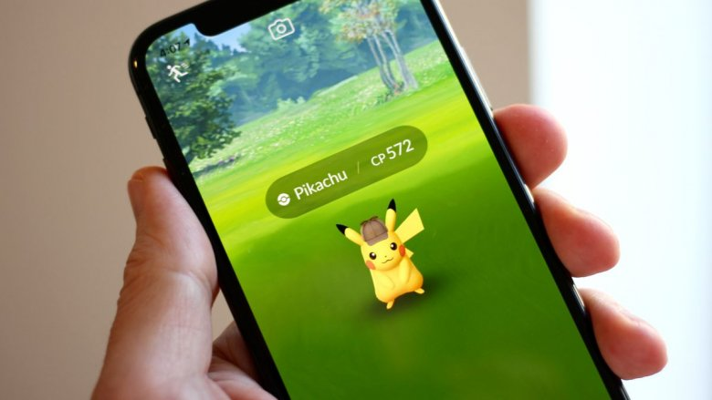
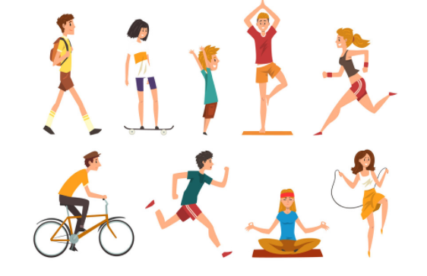
What Do We Want To Know?
Does playing Pokémon GO
have a positive influence on user’s physical health?
Can AR Games become
an Inhibitor of physical activity?

Slide 10
02
LITERATURE REVIEW

Slide 11
Microsoft Industry Study (Althoff et al., 2016)
+1473
+25%
3 times
+144 billion
Study group: 1,420 players (from 31,793 activity-shared Microsoft Band US users)
Player identification: Microsoft Bing search query keyword “Pokémon”
Control group: 50,000 randomly sampled Microsoft Band US users
Results for particularly engaged players ( >= 10 experiential queries):
Steps daily
(average)
Activity level
More likely to meet official guideline of 8,000 steps per day
Estimated more steps than would’ve been taken in the US
Notes:
Microsoft Band: Microsoft’s wearable smart device
Conclusion: Pokémon GO increased activity all across the studied population, largely independent of prior activity level, age, weight status, or gender.

Slide 12
Duke Clinical Research Institute Study (Xian et al., 2017)
+1976
+2816
+2134
+3031
Participant: 167 players (self-enrolled via flyers/social media)
Step counts recorded by iPhone Health app
June 15th ~ June 31st (3 weeks before/after Pokémon GO release)
Engagement measure: Pokémon GO trainer profile
Results of game playing:
Steps daily
(average)
Steps daily for overweight individuals
Steps if played 2-2.5hr (insignificant if < 1hr)
Steps daily every 10,000 XP gained
Notes:
Conclusion: Pokémon GO increased physical activity among young adults, with the largest increases seen in those who spent more time playing Pokémon GO, who were overweight, or with a lower baseline physical activity level (i.e. sedentary).

Slide 13
Lifestyle Effects Study (Gabbiadini et al., 2018)
YES
NO
Participant: 981 players (via anonymous web survey)
Data: Frequency of Pokémon GO app usage, overall physical activity, amount of app-related physical activity & attitude towards physical activity
More app usage: More app-related physical activity
Improved attitude towards physical activity
⇒ NO Long-term effect (i.e. NO change in lifestyle)
Notes:
We utilized the same data set as this study, but explored differently.

Slide 14
Comparisons with Previous Literature
Our Project VS Microsoft & Duke Study:
Examined impact of Pokémon GO by number of times exercised, vs step count.
Our Project VS Lifestyle Effects Study:
Investigated potential impact on physical activity in walking/running/biking respectively, vs averaging the 3 measurements.
Our reasoning: The game design (i.e. 0.11 miles/minute max for egg hatching or buddy distance to count) may not encourage app users to bike as much.
Experimented different regression models with interaction variables, discontinuity and diff-diff, vs hierarchical linear regression.
Did not investigate potential impact on long-term attitude change.

Slide 15
03
METHODOLOGY

Slide 16
Linear Regression ( P_{i} over AU_{i} and OP_{i} )
Regression Model Formula
P_{i}= α + β₁ AU_{i}+ β₂ OP_{i} + e_{i}
Variable Explanations
P = Frequency of each of the three physical activities (walking, running, and biking) measured on a scale of 1-7 (1= Never, 7= Everyday)
i = Individual
AU = App Usage with scale of 1-7 (1= Never used , 7= Most used)
OP= Frequency of the selected physical activity before playing Pokémon GO

Slide 17
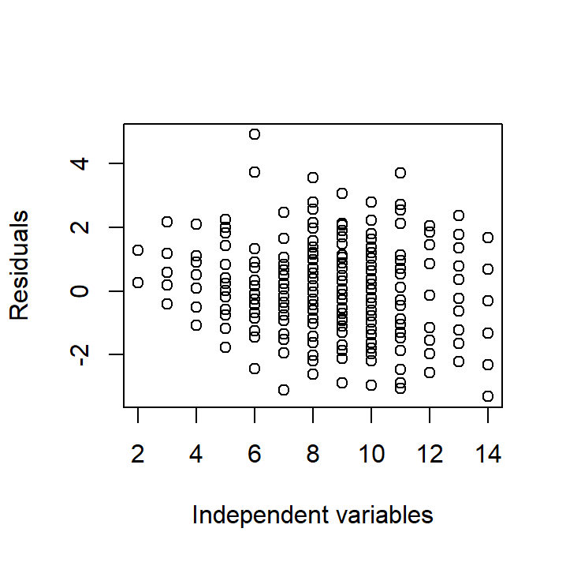
Linear Regression ( P_{i} over AU_{i} and OP_{i} )
SIGNIFICANCE
R SQUARED
RESIDUAL
Residuals show pattern indicating possible OVB
P-values of all independent variables are less than 0.05
Adjusted R squared is 0.7319 - 73.19% of the variance is explained by the model

Slide 18
Linear Regression ( P_{i} over interaction of AU_{i} x SS_{i} and OP_{i} )
Regression Model Formula
P_{i}= α + β₁ AU_{i}+ β₂ SS_{i} +β₃OP_{i} + θ (AU_{i} * SS_{I}) + e_{i}
Variable Explanations
P = Frequency of each of the three physical activities (walking, running, and biking) measured on a scale of 1-7 (1= Never, 7= Everyday)
i = Individual
SS= Social sharing frequency on a scale of 1-7 (7 being the highest)
AU = App Usage with a scale of 1-7 (1= Never used , 7= Most used)
OP= Frequency of the selected physical activity before playing Pokémon GO

Slide 19
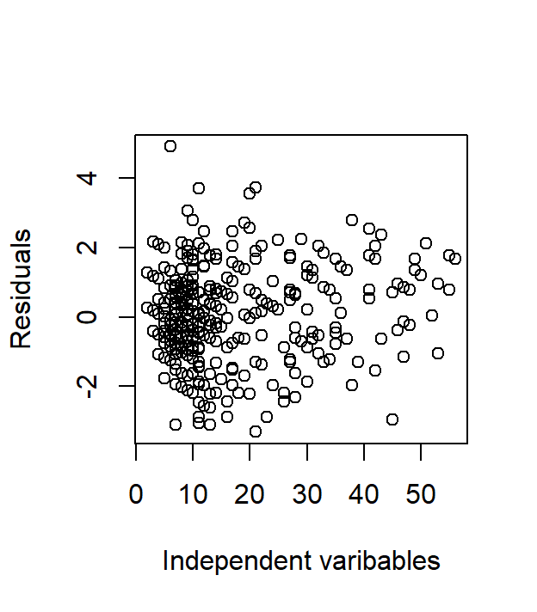
Linear Regression ( P_{i} over interaction of AU_{i} x SS_{i} and OP_{i} )
SIGNIFICANCE
R SQUARED
RESIDUAL
Residuals are randomly dispersed around the line
P-value of the interaction of app usage and social sharing is 0.24 portraying insignificance
Adjusted R squared is 0.7324, 73.24% of the variance is explained by the model

Slide 20
Linear Regression ( P_{i} over interaction of AU_{i} x OP_{i} , SS_{i} and Gender_{i} ]
Regression Model Formula
P_{i}= α + β₁ AU_{I}+ β₂ OP_{i} + _{i} β₃Gender_{i} + β₄ SS_{I} +θ (AU_{I X} OP_{i} ) + e_{i}
Variable Explanations
P= Frequency of each of the three physical activities (walking, running and biking) measured on a scale of 1-7 (1= Never, 7= Everyday)
i= Individual
AU= App Usage with a scale of 1-7 (1= Never used , 7= Most used)
OP= Frequency of the selected physical activity before playing Pokémon GO
Gender = Gender of the user (1=Male, 0= Female)
SS= Tendency to share on social media (Scale of 1-7 where 7 is highest)
Notes:
We first started by regressing Physical activities upon App usage and Past Physical activity
However, upon plotting the residuals, we saw a pattern amongst residuals. This implied Omitted Variable Bias.
We then interacted app usage with social sharing to study the difference in marginal effect of app usage upon Physical activity for different groups of social sharing
However, the interaction was not significant in the linear regression model implying no difference in marginal effects.
Next, we regressed each physical activity (walk, run and bike) over app usage, physical activity before Pokemon GO, age, gender, social sharing and interacted app usage with past physical activity.e found out that each of the variable is significant
There was no evident pattern in the residuals as well.
We therefore choose this model.

Slide 21
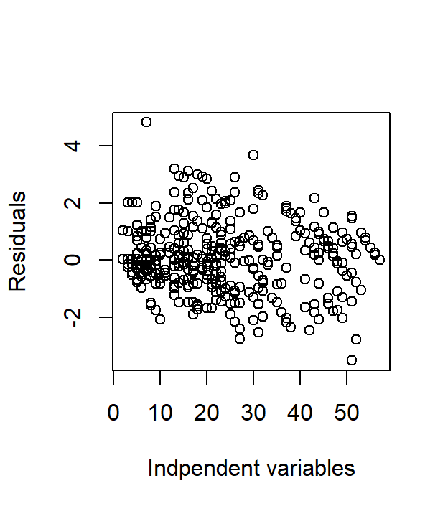
Linear Regression ( P_{i} over interaction of AU_{i} x OP_{i} , SS_{i} and Gender_{i} ]
SIGNIFICANCE
R SQUARED
RESIDUAL
Residuals are randomly dispersed around the line
All variables are significant
Adjusted R squared is 0.7863, 78.63% of the variance is explained by the model

Slide 22
T-Test
Prior to examining discontinuity, we tested whether there is difference between two groups using App Usage=2 as the cutoff, in frequency of exercise before playing Pokémon GO.
Y1= Frequency of past exercise for App Usage = 1 & 2 (i.e. those who didn’t/barely played)
Y2= Frequency of past exercise for App Usage > 2 (i.e. those who actively played)
H0: E[Y1]−E[Y2] = μ0 (μ0=0)
Ha: E[Y1]−E[Y2] ≠ μ0
P-values: Walking: 0.231; Running: 0.5951; Biking: 0.4739
⇒ Failed to reject H0: There is no significant difference in the number of times exercised prior to playing Pokémon GO, between those who did not/barely played Pokémon GO and active players.
Notes:
Reasoning of threshold selection (i.e. App Usage = 2) will be elaborated in notes of slide #24.

Slide 23
Regression Discontinuity
Regression Discontinuity Model
Y_{i} = α + β₁A_{i} + β₂B_{i} + β₃C_{i} + e_{i}
Variable Explanations
Our dataset is organized by app usage levels, as measured by 1 level intervals spanning from 1 to 7 with level 2 being the cutoff level (threshold)
Y: The log of total physical activity done (over 30 minutes) with the intent of searching for Pokémon during the last one month
i: App usage level group
A: Dummy variable indicating the treatment of whether Pokémon GO is used (1 if app usage level is 2 or more)
B: App usage level (in event time) (i.e. a linear control)
C: Control variables (i.e. updating the progress of Pokémon GO on social media)
Notes:
Here, the parameter β is the marginal effect on physical activity of being able to use the app (i.e. beyond level 2) controlling for other app usage related effects such as peer pressure, idle time, and social desirability.

Slide 24
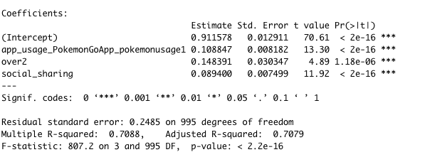
Regression Discontinuity
Results
Comparing the change in physical activity with respect to app usage at level 2 and beyond with social media sharing as a control variable, the results indicate that discontinuity is significant as indicated by the over2 and social_sharing variables.
Notes:
In order to choose a threshold, we have tested different options, app_usage = 2, app_usage = 3, and only at app_usage = 2 it is significant. We did not regard app_usage = 1 as an option because our independent variable is categorical, and having app_usage = 1 as the threshold would mean there is nothing below the threshold to compare.

Slide 25
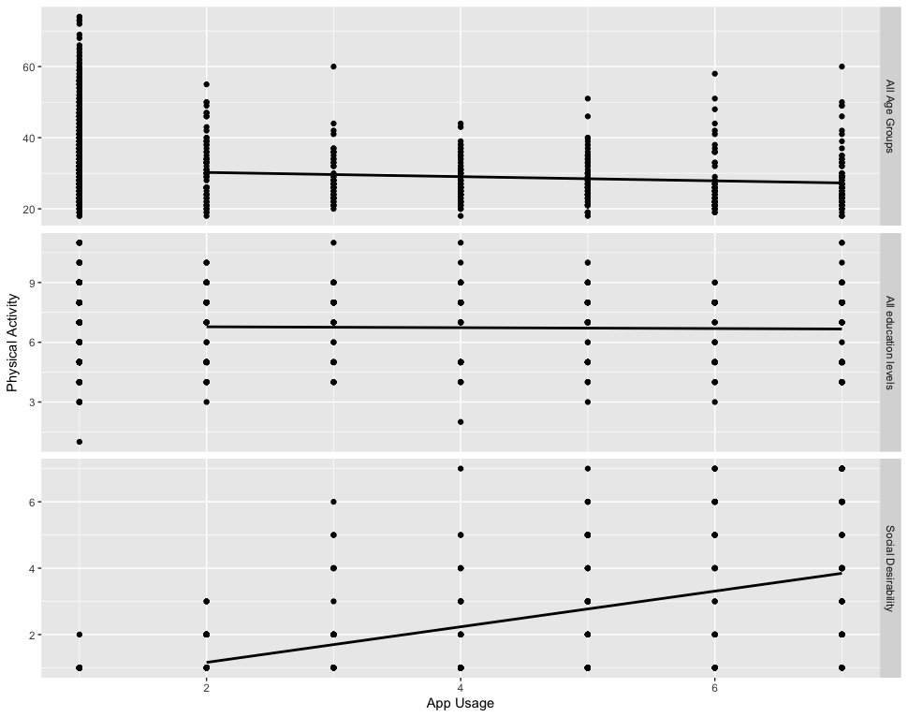
Regression Discontinuity
Additional Models For Regression Discontinuity
To test for additional control variables, Model 2 and 3 considered age and education as covariates respectively.
Comparing the change in physical activity with respect to app usage at level 2 and beyond for the two additional models, the results indicate that discontinuity is not significant for either over 2 or the two control variables

Slide 26
Diff in Diff
Method attempted, but failed to apply
Difference in Difference method is not applicable to our data for the following reasons:
For this method, cross-sectional data (before and after) are needed for the treatment and control group. However, our data is not a panel data.
Because we are already comparing the group using Pokémon GO and the group not using Pokémon GO, we cannot use ‘Pokémon GO First-time Usage’ as the event that divides 2 periods.
Even if we assume that there is some kind of event that divides the time into before Pokémon GO usage and after Pokémon GO usage and the physical activity frequency of people does not differ solely by itself(assuming a trend),
the result is meaningless
 | Period 1 (Before Usage) | Period 2 (After Usage)
Pokemon GO User | X | X + Y
Pokemon GO Non-User | X | X
Even with the assumptions,
‘Y’ is NOT the treatment effect
we want to find out

Slide 27
04
DATA

Slide 28
DATA SUMMARY
SOURCE
“Does Pokémon GO lead to a more Physical Active Lifestyle”, OSF Home, created on March 6, 2018.
DATA CLEANING
The original data set is in SPSS format, we converted it to CSV
Dropped variables: id, submitdate, apaddr, ATTENTION_filter1
We reversed the originally reversed scores, then
Took an average of the attitude questions (avg_attitude)
Took an average of the step attitude questions (avg_stepattitude)
Notes:
The explanation of each variable is included in the appendix.

Slide 29
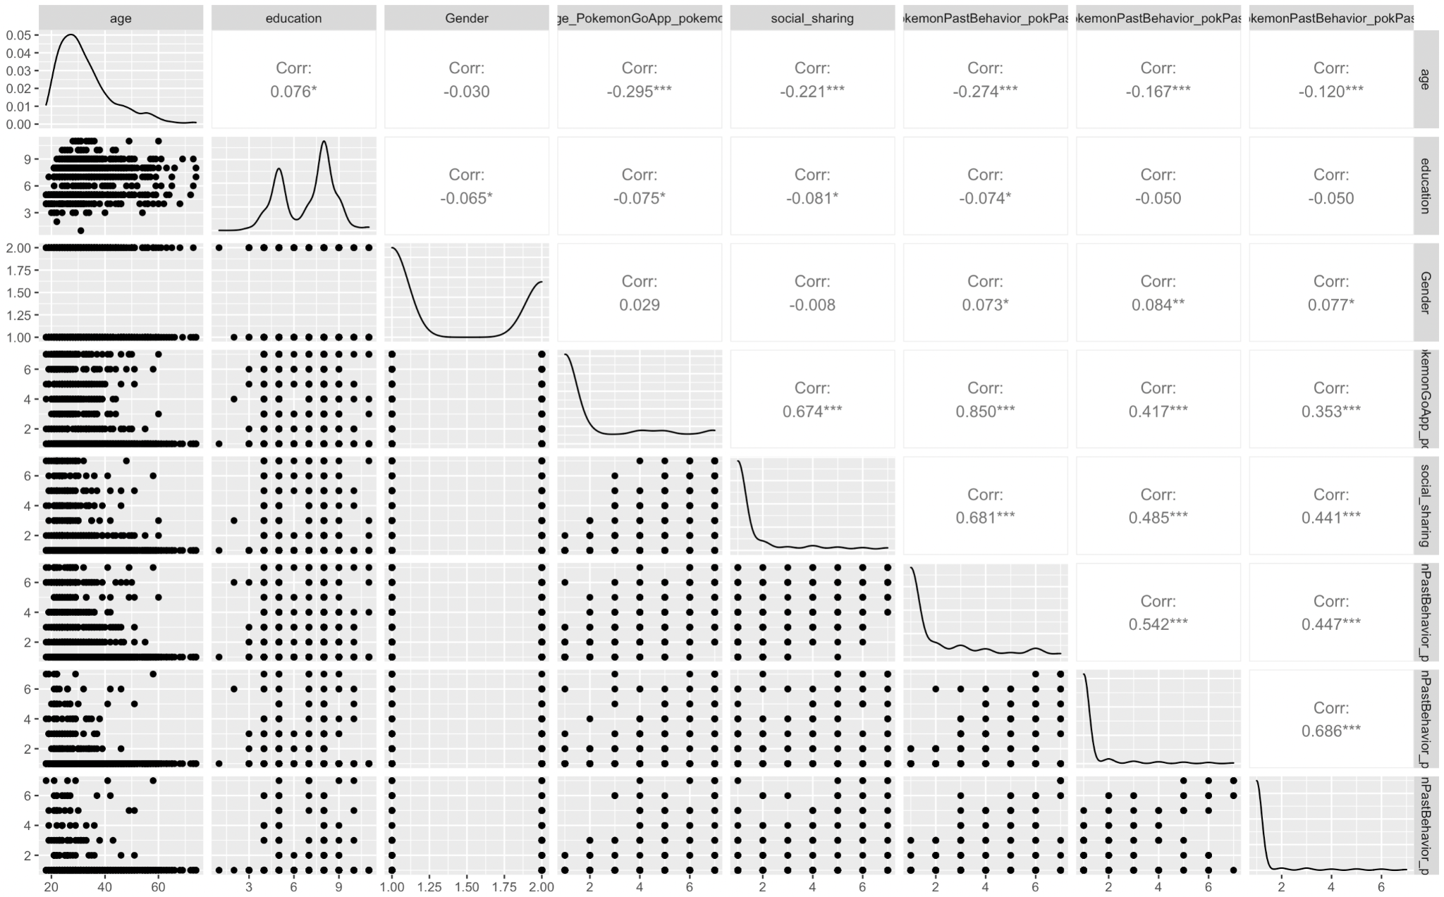
EDA
Notes:
From this analysis we can gaspy an initial understanding of the data. It conveys the possible values and correlation between variables.
There is a high correlation between social sharing and app usage, this is reasonable because when users desire to share on social media, they tend to use the app more often to create shareable contents.
We could also see that Pokemon-related walking has a higher correlation with app usage than running and biking. This is because most of the people who play Pokemon GO tend to walk to catch Pokemon.

Slide 30
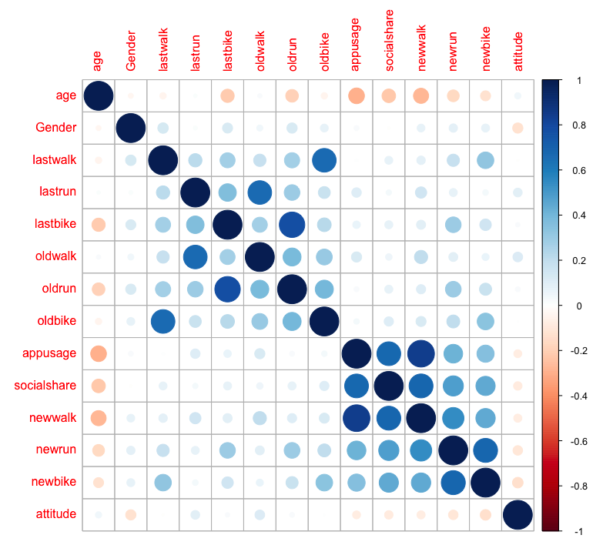
Correlation Plot
Notes:
Definition of re-named variables:
lastwalk, lastrun, lastbike - last time participants had a walk, run, and bike
oldwalk, oldrun, oldbike - frequency of walking, running, and biking for the purpose of exercise
newwalk, newrun, newbike - frequency of walking, running and biking for the purpose of playing Pokemon GO
The correlation plot shows the correlation magnitude between several variables related to using the Pokemon GO app to impact the physical activity. The following few are what we find most interesting and critical to our study:
Appusage has a positive correlation with newwalk, newrun, and newbike, but the correlation with newwalk is the largest.
Age has a negative correlation with appusage, meaning the older participant is, the less time they will spend on the Pokemon GO app.
Age is negatively correlated with socialshare, meaning the older the age, the less they share their Pokemon experience on social media.
Socialshare is positively correlated with newwalk, newrun, and newbike. This indicates that social sharing positively reinforce physical activities associated with Pokemon GO.

Slide 31
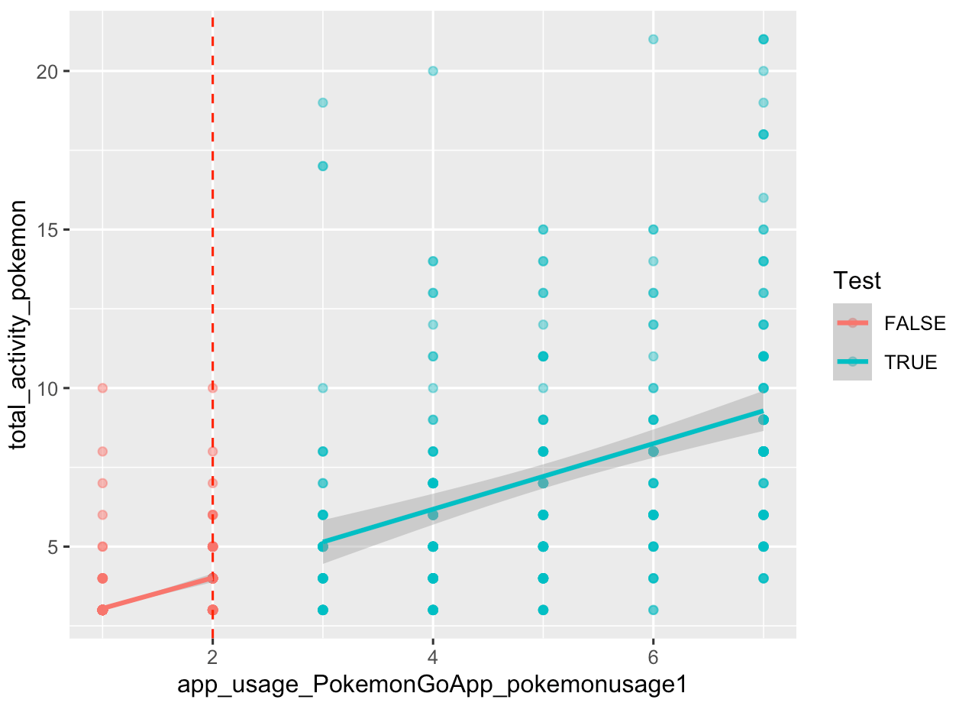
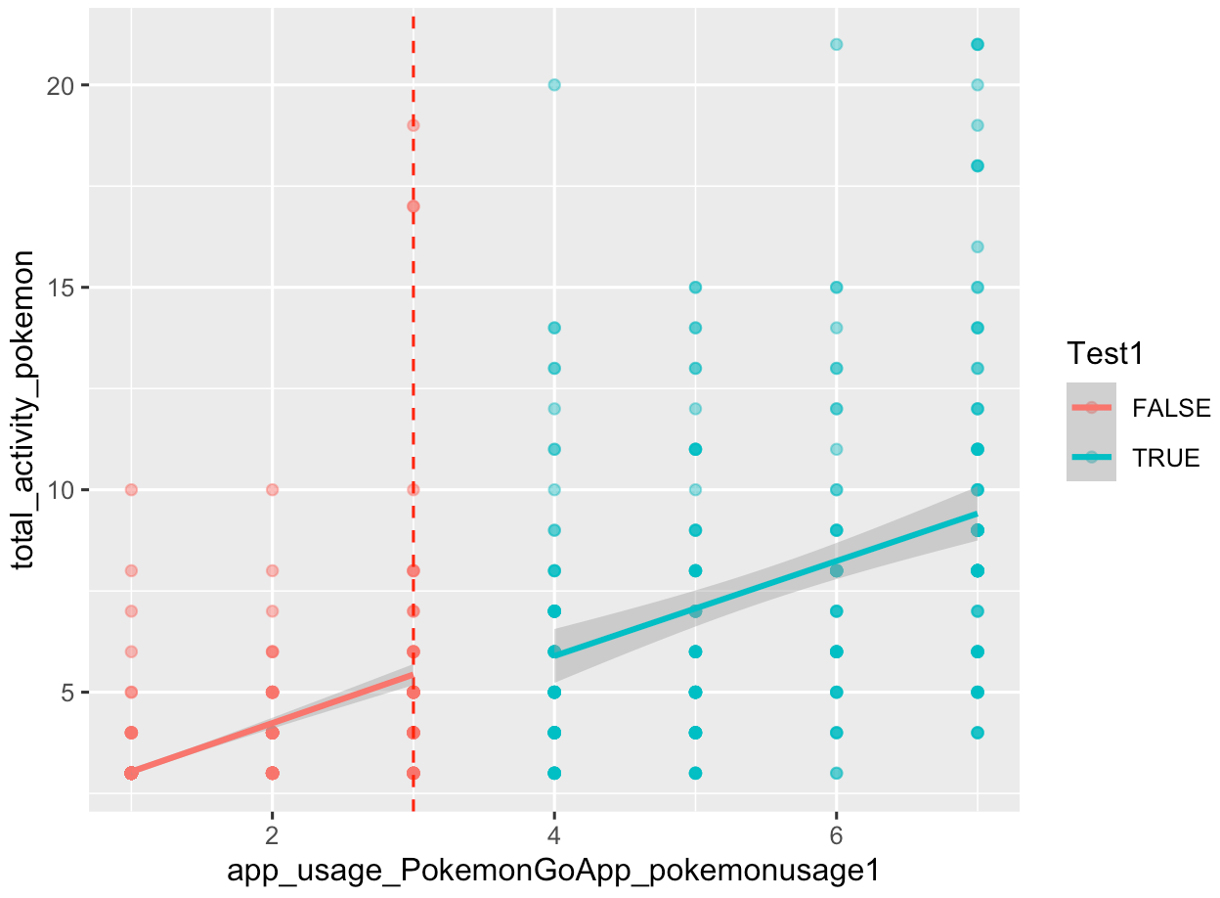
Regression Discontinuity
Threshold = 2
Threshold = 3
Notes:
Since our independent variable is categorical, ranging from 1~7, we decided to manually test the thresholds with graphs first and see if there exists a regression discontinuity. At a first glance from the graph there doesn’t seem to have a discontinuity, but we suspect it is because of scaling, meaning that if we zoom into the disconnected part of the graph, we will be able to see a jump. Later we ran a few models to test our theory.

Slide 32
05
FINDINGS

Slide 33
Linear Regression ( P_{i} over interaction of AU_{i} x OP_{i} , SS_{i} and Gender_{i} ]
 | Estimate (Walk) | P-Value (Walk) | Estimate (Run) | P-Value (Run) | Estimate (Bike) | P-Value (Bike)
Intercept | 0.517024 | 5.99e-08 | 0.96264 | < 2e-16 | 0.837301 | < 2e-16
AU_{i} (App Usage)- β1 | 0.196049 | 5.13e-08 | -0.15579 | 1.17e-14 | -0.131741 | 1.18e-12
OP_{i} (Frequency of exercise before using Pokemon Go)-β2 | -0.071454 | 0.000173 | -0.11129 | 2.05e-09 | -0.098020 | 1.79e-06
Gender_{i-} β3 | 0.179996 | 0.000427 | 0.09011 | 0.0533 | 0.102465 | 0.0243
SS_{i} (Social Sharing)-β4 | 0.257709 | < 2e-16 | 0.19032 | < 2e-16 | 0.164415 | 2.47e-14
AUi* OPi - θ | 0.073969 | < 2e-16 | 0.10465 | < 2e-16 | 0.099421 | <2e-16
Notes:
We ran three regressions for each Physical activity (Walking, Running and Biking)
We observe the β1 to be 0.19 meaning the frequency of walking increases by 0.19 when app usage increases by 1 on average when ceteris paribus.
However in case of Running and Biking, the coefficients were negative indicating that Running and Biking post Pokemon GO decreased by 0.15 and 0.13 respectively.
β2 captures the marginal effect of physical effect prior to Pokemon Go on physical activity post Pokemon GO.The negative β2 indicates that when each Physical activity prior to Pokemon GO increased by 1, walking for Pokemon GO on average decreased by 0.07 for Walking, for 0.11 for Running and 0.13 for Biking when ceteris paribus.
The positive coefficient of β3 for all 3 models indicate that Physical activity for Male on average was more than Females by 0.17 for walking, 0,09 for running and 0.102 for biking when ceteris paribus.
The β4 captures the marginal effect of Social sharing on Physical activity. For increase in social sharing by 1, walking, running and biking increases by 0.258,0.190 and 0.164 on average respectively when ceteris paribus.
The θ captures the difference in marginal effect of App usage on Physical activity for Pokemon GO for different stages of Physical activity prior to Pokemon GO.

Slide 34
OUR FINDINGS (REGRESSION)
Pokémon GO causes players to increase their level of activity but this effect is only seen in the frequency of walking that players have done for the purpose of the game
The app causes players to decrease their level of activity for running and biking, This is due to the fact this game can only be played optimally while Walking. Certain features of the app (egg hatch, pokemon spawns) do not work when you are running or biking. 1
Including an interaction
The difference in marginal effect of app usage upon walking for different levels of social sharing is insignificant
The marginal effect of app usage on Physical activity is however different for different levels of Past physical activity
Males on average have a greater increase in Physical activity as compared to Females
Age and education had no significant impact

Slide 35
OUR FINDINGS (RD)
T test shows that there is no significant difference between the two groups (those who did not/ barely played and active players) frequency of physical activity before the introduction of Pokémon GO
We see a difference at the threshold of app_usage = 2 (meaning that a player has used the Pokémon GO app over 3o minutes for 2 times in the past month)
The impact of this intervention (app_usage = 2) is measured by our model.
When controlling for social sharing, the level of increase from before the threshold is 14.84%
When controlling for education or age, we cannot conclude that there is an increase around the threshold

Slide 36
06
CONCLUSIONS / LIMITATIONS

Slide 37
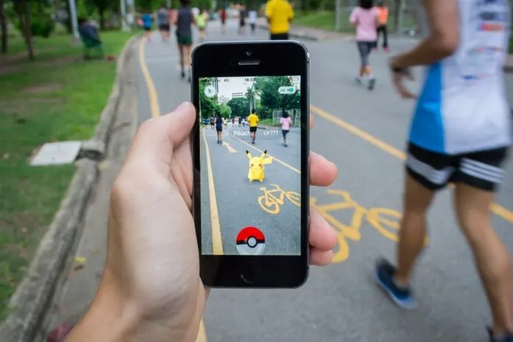
Pokemon GO: Inhibitor of Physical Activity
What We Wanted To Know
Does playing Pokemon GO have a positive influence on user’s physical health?
Yes, especially walking
Based on the result of Linear Regression
Regression Discontinuity
As the frequency of using Pokemon GO increases for an individual, the individual will engage more frequently in walking for the purpose of playing the game
Notes:
The level of Pokemon GO usage in fact motivated players to engage in more physical activities for the purpose of catching Pokemon.

Slide 38



Deployment with our project result
With the project result, NIANTIC Can successfully...
Develop on the new competitive strength point
Opportunities of New Market Penetration
Opportunities of New Segmentation / Targeting Strategy
Combined with plenty of studies supporting that Pokémon Go helps boost user’s mental health, the synergy will be great.
Penetration to new health or physical activity related markets with huge size and potential (e.g. outdoor wearable industry through strategic alliance and more
E.g. Parents with young children
- Parents concerned with children’s greatly increasing indoor spending time
- Studies proving side benefits parents gain by playing Pokémon Go with children
Notes:
Especially regarding 1), NIANTIC can think about which demographic group(Segmentation / targeting) should the company emphasize their new strategic advantage to most. For instance, NIANTIC can target ‘Parents with young children’ as 1) many parents are thinking of ways to make their children physically active 2) there are actually many side benefits that parents can gain by playing Pokemon GO with their children 3) parents are those who have the economic ability to make payments in Pokemon GO for their children. Or NIANTIC can consider targeting older group (in their 20s) as they seem to account the most of Pokemon GO users
Parents who play Pokemon with their family gain many side benefits: https://www.washington.edu/news/2017/03/28/parents-who-play-pokemon-go-with-kids-it-wasnt-really-about-the-pokemon/

Slide 39



LIMITATIONS
OUTDATED DATA
SELF REPORT
SHORT TIMELINE
The data was collected in 2016, which is outdated for gaming industry, especially given the fast growing AR technologies.
Participants were asked to self-report, which could be biased due to social desirability.
Data was only collected within the one month period. We are not certain if it proves sustainable effect.

Slide 40
07
APPENDIX

Slide 41
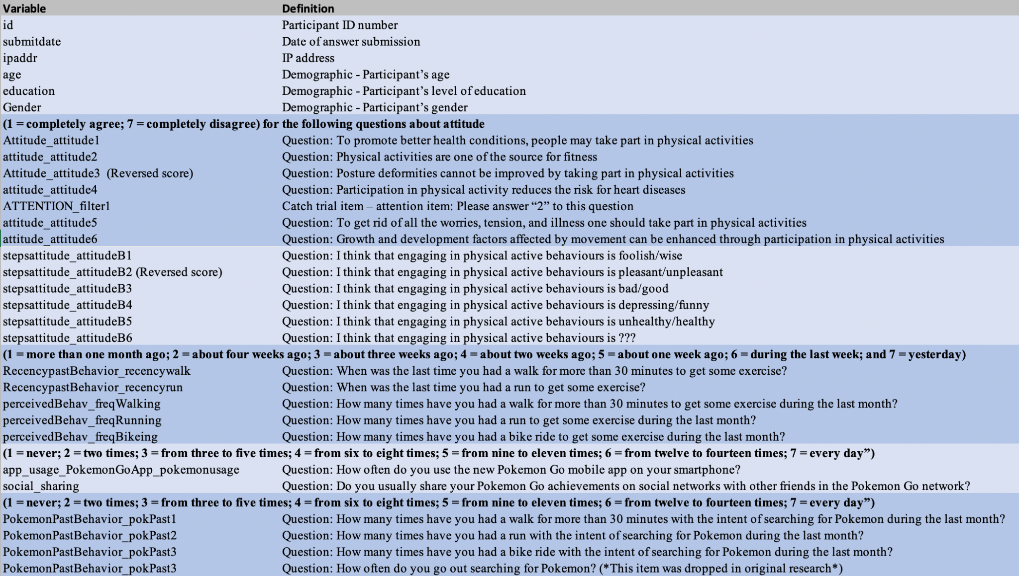
Variable Definitions

Slide 42
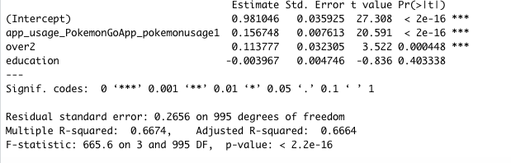
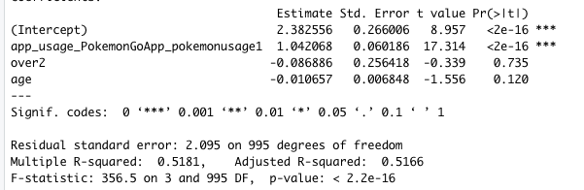
Regression Discontinuity - Models 2 and 3
2
3

Slide 43
Reference
Alloway, T. P. (2020). Feeling Down? Try Pokémon Go. Psychology Today. https://www.psychologytoday.com/us/blog/keep-it-in-mind/202010/feeling-down-try-pok-mon-go
Alloway, T. P., & Carpenter, R. (2021). “Gotta Catch ‘Em All” - Can Playing Pokémon Go Influence Mood and Empathy? Psychology of Popular Media, 10(2).
Althoff, T., White, R. W., & Horvitz, E. (2016). Influence of Pokémon Go on Physical Activity: Study and Implications. Journal of Medical Internet Research, 18(12).
Bass, D. (2021). Pokémon Go Creator Has a Plan to Be More Than a One-Hit Wonde. Bloomberg BusinessWeek. https://www.bloomberg.com/news/articles/2021-06-14/following-pokemon-go-niantic-plans-transformers-game-ar-tech-for-developers
Gabbiadini, A. (2018). Original dataset: Does Pokémon Go lead to a more physically active life style? . https://osf.io/xy5g6/
Gabbiadini, A., Sagioglou, C., & Greitemeyer, T. (2018). Does Pokémon Go lead to a more physically active life style? Computers in Human Behavior(84).
IMARC-Group. (2021). Augmented Reality Gaming Market: Global Industry Trends, Share, Size, Growth, Opportunity and Forecast 2021-2026. Research and Markets. https://www.researchandmarkets.com/reports/5263997/augmented-reality-gaming-market-global-industry?utm_source=BW&utm_medium=PressRelease&utm_code=rj3vdw&utm_campaign=1505708+-+Global+Augmented+Reality+Gaming+Market+(2021+to+2026)+-+Industry+Trends%2c+Share%2c+Size%2c+Growth%2c+Opportunity+and+Forecasts&utm_exec=jamu273prd

Slide 44
Reference
Iqbal, M. (2021). Pokémon Go Revenue and Usage Statistics (2021). Business of Apps. https://www.businessofapps.com/data/pokemon-go-statistics/
Langston, J. (2017). Parents who play ‘Pokémon GO’ with kids: ‘It wasn’t really about the Pokémon’. UW News. https://www.washington.edu/news/2017/03/28/parents-who-play-pokemon-go-with-kids-it-wasnt-really-about-the-pokemon/
Sonders, M. (2016). Pokémon GO demographics: The evolving player mix of a smash-hit game. SurveyMonkey Intelligence. https://medium.com/@sm_app_intel/pok%C3%A9mon-go-demographics-the-evolving-player-mix-of-a-smash-hit-game-b9099d5527b7
Srivastava, M. C. (2019). Pokemon GO Revenue, Statistics And All Figures Revealed. Mobile App Daily. https://www.mobileappdaily.com/2018/07/27/pokemon-go-revenue-statistics
Xian, Y., Xu, H., Xu, H., Liang, L., Hernandez, A. F., Wang, T. Y., & Peterson, E. D. (2017). An Initial Evaluation of the Impact of Pokémon GO on Physical Activity. Journal of the American Heart Association, 6(5).

